Slide 1


Personal Emergency
Preparedness & Crime Prevention
Preparing Our Community. Working Together.
OES Chief Kenneth Dueker, J.D.
Director of Emergency Services
www.cityofpaloalto.org/publicsafety
Rev. 19 AUG 2018 K. Dueker

Slide 2
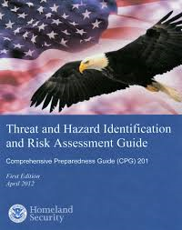

Learning Objectives
Understand our Community’s Risk Profile: Day-to-Day and Disaster
Understand Local Capabilities
Role for Everyone: You are not de facto victims!

Slide 3
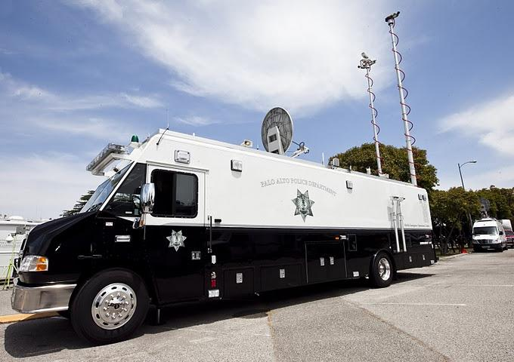
Palo Alto Public Safety
Police Department, Office of Emergency Services, Fire Department (other City departments support, as well)
Day-to-Day Emergencies, Special Events, Dignitary Visits, Stanford University
Mutual Aid
Risk-Based
Other Factors:
Public Safety Building
Communications
Public Information
Regional Factors
Murphy’s Law
Unknown-Unknown

Slide 4




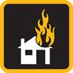


Palo Alto Risk Scorecard
Threats and Hazards of Most Concern
Natural | Technological | Human Caused
Earthquake | Airplane Accident | Major Crime
Flood/Severe Winter Storm | Hazardous Waste/ Materials Spill | Cyber Attack
 | Urban Fire | Workplace Violence
 |  | Civil Unrest
Methodologies discussed in THIRA report
Not a static or exclusive list (living document)
Can be “black swan” events, such as Coronal Mass Ejection (CME) or EMP …
Learn more on www.cityofpaloalto.org/thira

Slide 5
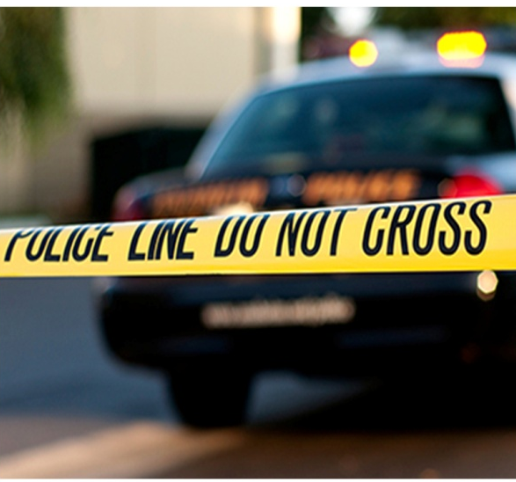
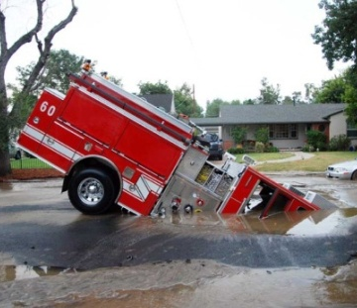
Consequences & Magnitude
Plan for a major earthquake = covers most other scenarios
Weeks with little / no utilities
Weeks with reduced medical care
Months with damaged transportation
Disaster within the Disaster
  Opportunistic crime (looting, etc.)
  Environmental damage: debris
  Damage to infrastructure, economy
  Psychological impact

Slide 6
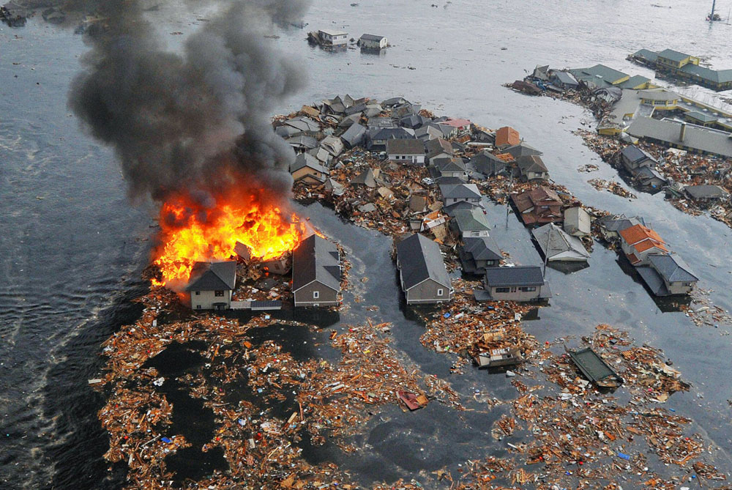
We have not yet had a Katrina-level disaster in our area’s history
…it is time to get prepared.

Slide 7
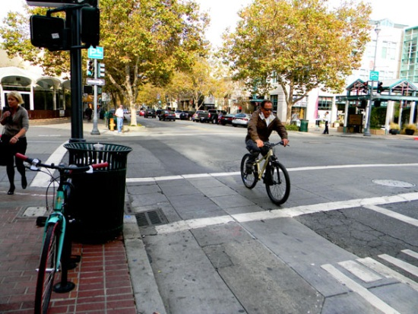
DISASTER PREPAREDNESS
The Big Picture
We believe that everyone has a role to play in 1) day-to-day crime prevention and personal safety and 2) disasters. To be effective, community members must understand:
What the City resources and plans are vs. the threats we face
That residents, students, businesses, and other community members are responsible for certain preparation and response roles
We are all in this together!

Slide 8
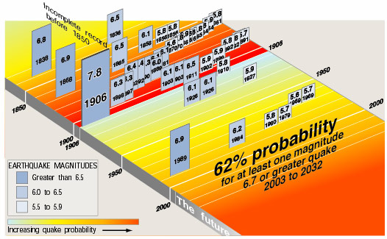
Earthquakes in The Bay Area
Our “quiet time” may be coming to an end

Slide 9
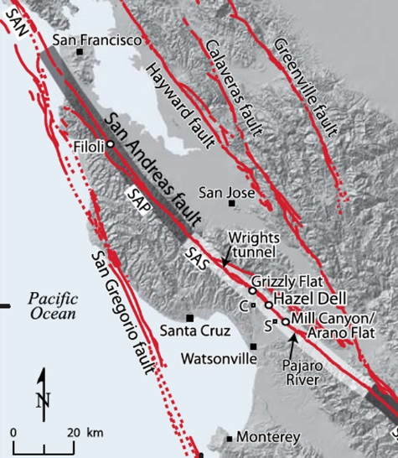
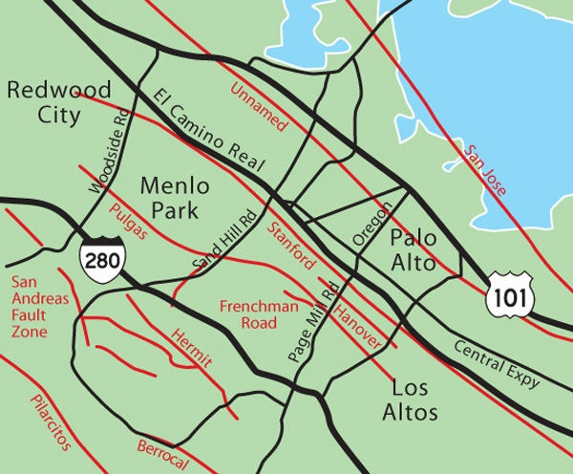
Local Faults

Slide 10
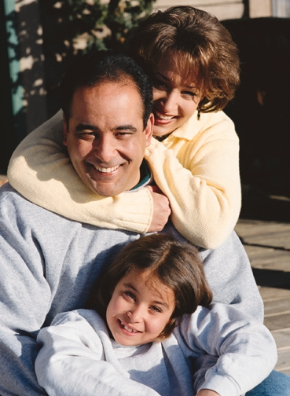

PERSONAL PREPAREDNESS
Make a Home/Family Plan
Build a Disaster Kit
Be Aware - Be Informed
The better prepared you and your neighbors are, the less of a burden is created on our limited first responder resources.

Slide 11
What Not to Do in a Large Scale Disaster
Do NOT go to the hospital, except in the case of a medical emergency.
Do NOT go to the fire or police station.
Do NOT light matches or turn electrical switches on or off if you smell gas or think there may be a leak.
Do NOT turn off any utilities unless you have been told to by emergency authorities --- or unless you know there has been some damage to gas pipes, water pipes, or electrical lines.
Do NOT drive your vehicle unless you have been advised to evacuate or you have a medical emergency. Be sure to check on road conditions and travel restrictions.
Do NOT call 9-1-1 except in the case of a life-threatening situation. It is important to keep these lines open for true emergencies.

Slide 12
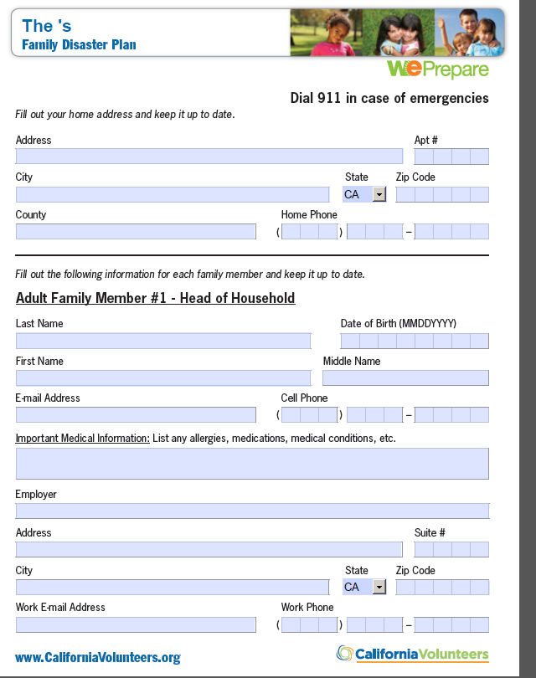
MAKE A HOME / FAMILY PLAN
Talk - What will you and your family do?
Make sure everyone knows and understands the family’s emergency communications plan.
Download the forms from
cityofpaloalto.org/preparedness
Practice your emergency plan!

Slide 13
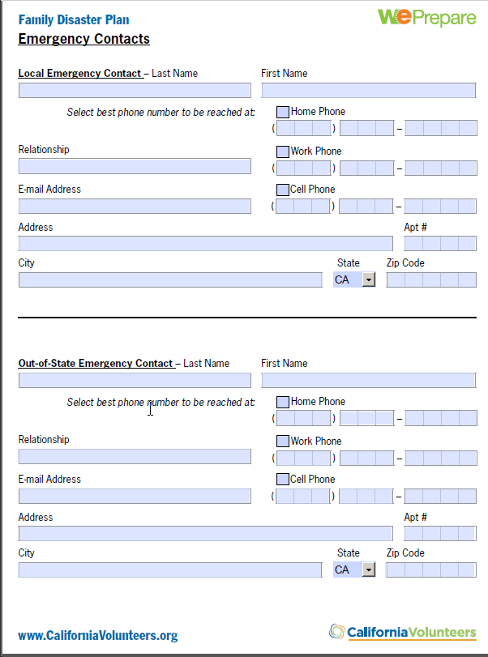
EMERGENCY CONTACT
Choose someone outside your household to call after an earthquake.
Best contact is Out-of-State
Tell them they have been designated and inform them of the plan.
After a disaster, each family member should call to tell that person they are OK.
Red Cross Emergency App
(if there’s Internet, of course)

Slide 14
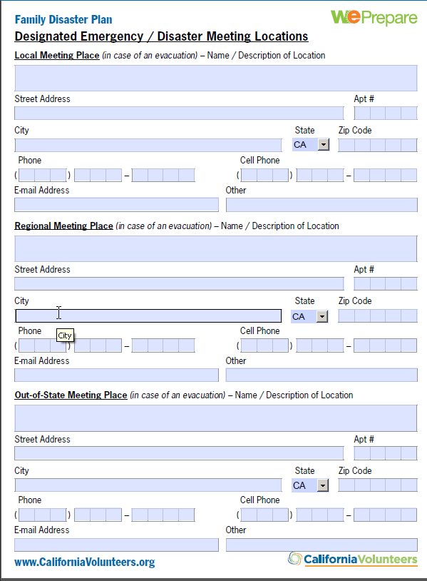
EMERGENCY MEETING
LOCATION

Slide 15
DON’T FORGET YOUR PETS!
Plan for the care of pets.
Gather pet supplies:
Food, water, meds, medical records.
Make sure pets have proper identification and shot records.
  Consider a microchip
Have a pet carrier or leash available.
Pictures for identification
For large animals, identify special methods for transportation

Slide 16
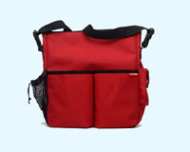
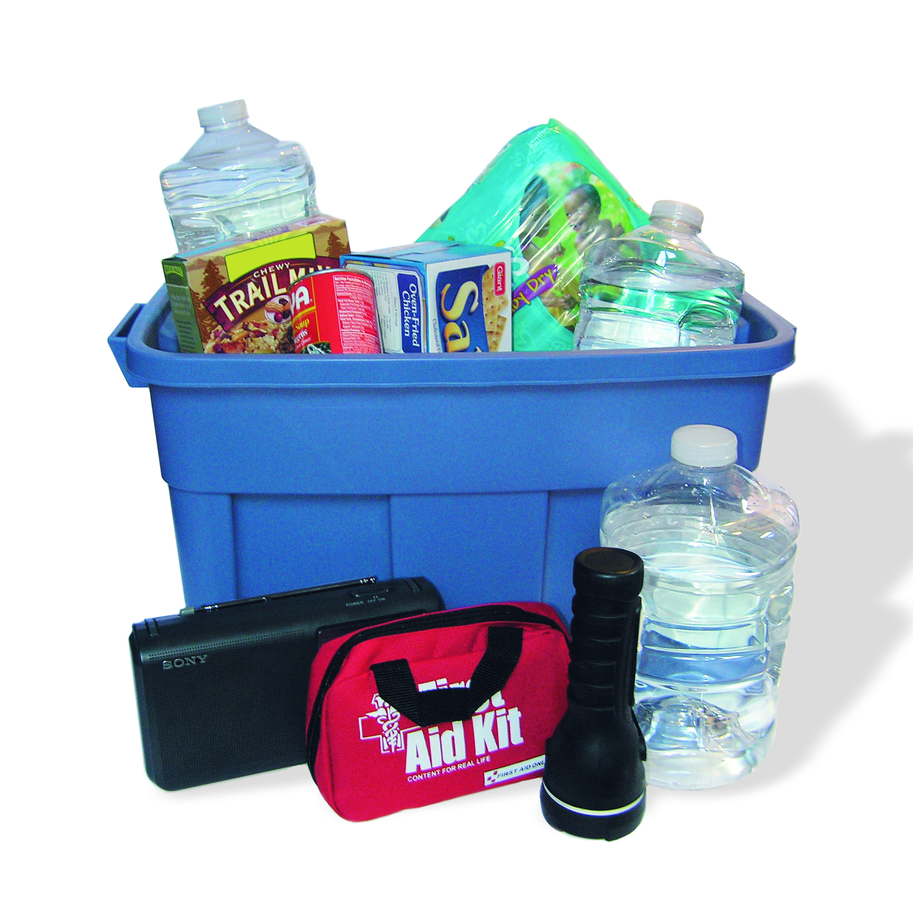
BUILD AN EMERGENCY
SUPPLY KIT
Include a contact information list of family and friends.
Check your kit frequently and re-stock used items and outdated products. Keep a check list with your kit.
Address specific needs
  Eyeglasses/Hearing aids
  Medications
  Mobility/transportation issues
  Specific dietary needs
Make a record of personal property: photo or video.
Store important records, pictures/videos in a secure location away from the home.
Good lists of supplies are posted:
cityofpaloalto.org/preparedness
paneighborhoods.org/paloaltoready
Car and Office
Home Kit

Slide 17
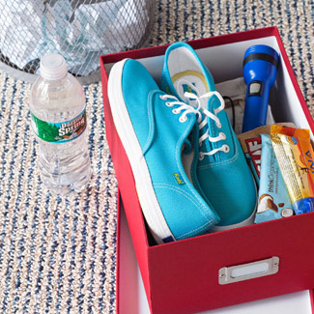
BUILD A KIT – Continued
Place a box or container under your bed and all your family members with the following items in it:
Pair of shoes
Flashlight
Whistle
Other
Food: Energy bar
Water
Action Item:
Prepare at work and at home.
Prepare your neighbors.
For 7 days (not 72 hours)!

Slide 18
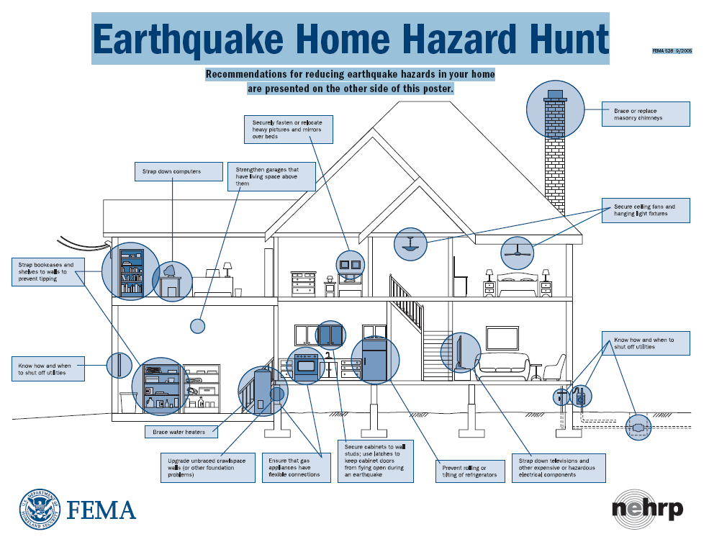
MITIGATION& PREVENTION
Seismic Safety:
Safety provisions in building codes
Retrofitting programs
Bolting and anchoring the foundation
Home Hazard Hunts www.fema.gov

Slide 19
BE INFORMED
Notifications from AlertSCC.com
Sign up for Public Safety social media and notifications: cityofpaloalto.org/PAPDconnect
Emergency Alert System and other broadcasts from
  KZSU – 90.1 FM (reminder: PAPD can “take over” this channel)
  KCBS 740 AM / 106.9 FM
If phones/internet fail, you need to know who has a connection to authorities (BPC, NPC) and that neighbors will be helping neighbors.
Find out what are the emergency plans & procedures for your
    neighborhood or residential facility
    family members’ places of employment; schools
    faith institution

Slide 20

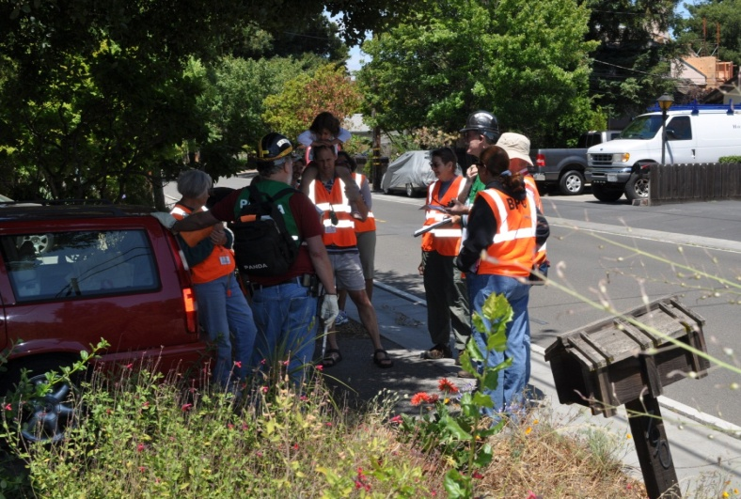
Get Involved:
VOLUNTEER RESOURCES
Palo Alto Has Several Types of Emergency Services Volunteers:
Block Preparedness Coordinators (BPC): “Eyes and Ears” for Neighborhoods and some businesses. Each neighborhood has a Neighborhood Preparedness Coordinator (NPC).
CERTs Can do light search and rescue and first aid.
NPCs are issued radios by the Police Department/OES that can communicate with the City – very important resource!
We need ESVs – there is a role for everyone. Learn more on:
cityofpaloalto.org/emergencyvolunteers

Slide 21

BLOCK PREPAREDNESS COORDINATOR
Information Sharing
Social
Crime
Emergency/Disaster

Slide 22

CRIME PREVENTION
Crime in your area:
crimereports.com
  We have incorporated Neighborhood Watch (NHW) into the Block Preparedness Coordinator Program
  The key elements of NHW are
    Neighbors getting to know neighbors
    Be aware of your normal neighborhood activities
    Be suspicious of activities or situations that are “unusual” or “out of the ordinary.”
    Learn how to be a good witness
    How & when to call the Police
    Communicate with your neighbors
    Learn security techniques & implement them
cityofpaloalto.org/publicsafety
cityofpaloalto.org/StopCrime

Slide 23
CRIMES OF OPPORTUNITY
For the most part, if you can take away a criminals opportunity, you can stop the crime. Most are cowards.
An organized block/neighborhood is generally in a better position to deter, deny, delay criminal activity - if you are divided, you are more easily conquered.
The more you do to keep your home from looking like an easy target, the safer the home usually is.
Lock It or Lose It: In recent cases, the confirmed point of entry in a large portion of the residential burglaries was through open or unlocked doors or windows.

Slide 24
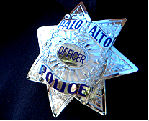
BURGLARY vs ROBBERY
Burglary is the “unlawful or forcible entry or attempted entry into a residence " with the intent to commit a crime.
Robbery is the felonious taking of personal property of another, from his person or immediate presence, and against his will, accomplished by means of force or fear.

Slide 25

Robbery: STREET PRECAUTIONS
Be alert to your surroundings & the people around you
Whenever possible, travel with a friend
Stay in well lighted areas as much as possible
Walk close to the curb. Avoid doorways, bushes and alleys
Walk confidently, and at a steady pace
Make eye contact with people when walking
Do not respond to conversation from strangers on the street
If you carry a purse, hold it securely between your arm & body
Walk facing traffic
If you feel you are in danger, don’t be afraid to run or scream
Keep your cell phone charged and activated

Slide 26
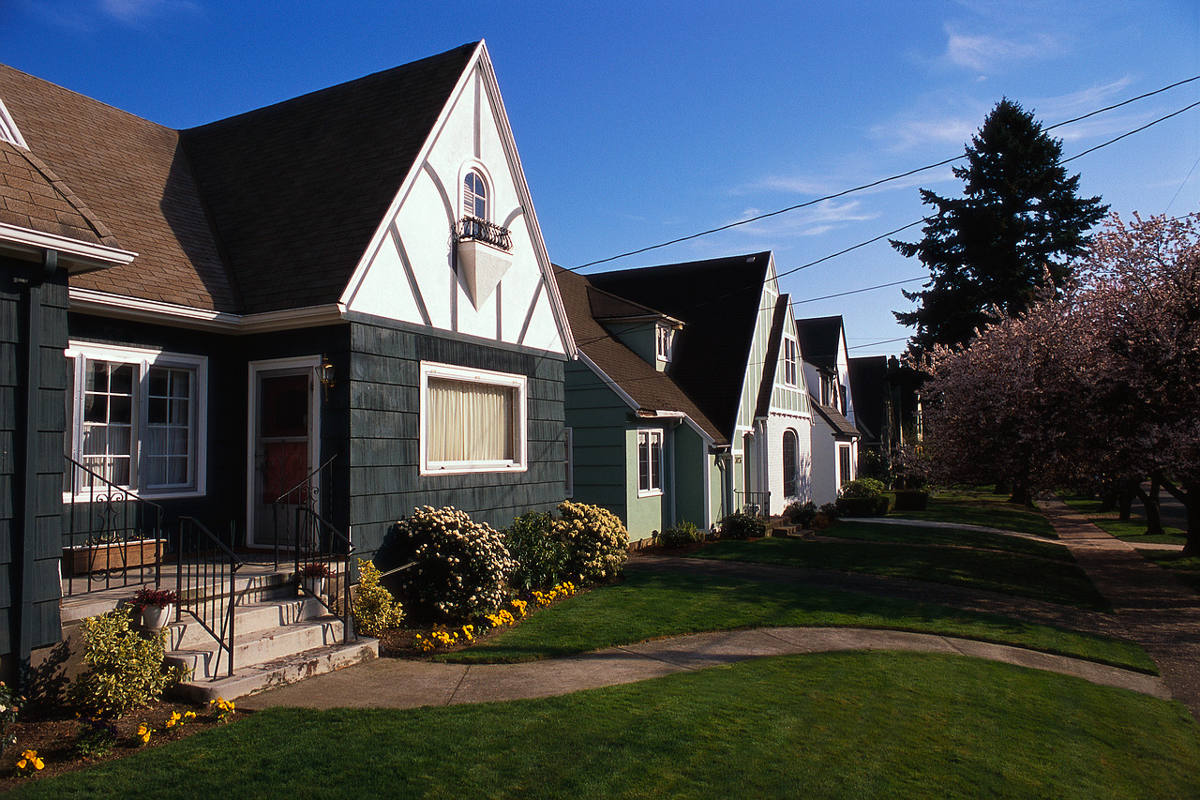
PREVENTING HOME BURGLARY
TARGET HARDENING

Slide 27
SECURITY RECOMMENDATIONS
DOORS - Entry doors should be solid wood or metal with properly installed doorframes
DOORS - hinges on the inside, or if exposed, hinges should be secured with hidden, non-removable pins
DOORS - All doors have a single-cylinder deadbolt, with a minimum of 1” bolt
DOORS - Strike plate should be security quality
WINDOWS - All windows have a working, locking mechanism
GATES – Use steel padlock and hasp
LIGHTS - All entry ways should be well lighted, including backyards. Consider motion activated lights or timers.
LANDSCAPING – Trim plants from doors and windows for visibility
PROPERTY LIST – Engrave valuable property (telephone number), photograph jewelry, art & collectibles, list serial numbers – take a video (insurance claims).

Slide 28

DOORS AND LOCKS
Change the locks when moving into a new
residence
Keep your doors locked at ALL times
Consider having a wide-angle (180°) door viewer
installed in the entry door
NEVER hide a key outside (or at least not in an obvious spot!)
If you suspect your residence has been entered,
DO NOT go in. Notify police immediately!

Slide 29
WINDOWS
Secure and lock windows when not in use and anytime you leave your residence
Close blinds and curtains after dark
Secure sliding patio doors and bathroom windows, etc. with a piece of wood (dowel stick) in the track
Auxiliary locking devices can be used for added security

Slide 30
SOLICITORS & STRANGERS AT YOUR DOOR
Never open your door for a stranger
If a delivery or repair person arrives without notice, do not let them into your home. Verify with their office.
Respond to the “knock” by talking through the door. By not responding, the person may assume no one is home – & they may try your doors or go around back …
In the City of Palo Alto, all solicitors (except certain non-profit and political) are required to have a permit, issued by the PAPD. Ask to see it.
Post a “No Solicitors” sign. It may reduce your contacts. PAMC Sec. 4.30.100(a) “No person shall solicit funds at any time at any building where there is a posted sign stating ‘No solicitors,’ or words to that effect ….”

Slide 31
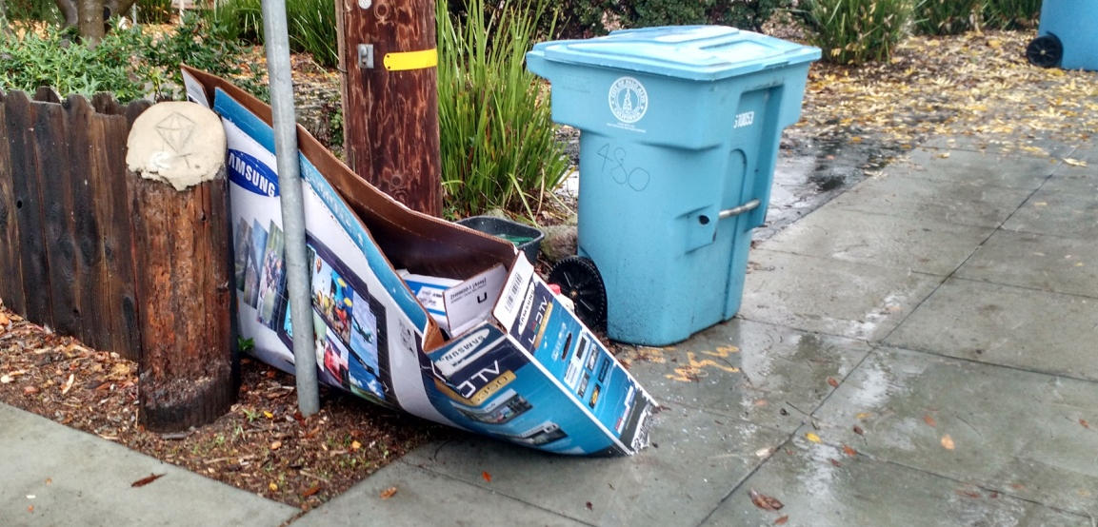
GENERAL SECURITY
Always lock your doors, whether you are at home or away. Criminals will check your doorknob if you don’t answer the door.
When you’re not at home, make it look as though somebody’s there (use timers for lights and leave radio on)
Never let people know when your home will be unoccupied
Avoid advertising your
expensive purchases:

Slide 32
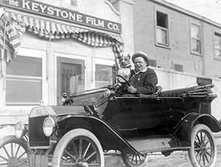
PROTECTING YOUR VEHICLE

Slide 33
AUTO BURGLARY PREVENTION
If you have a garage, use it. Lock your garage door. Lock your vehicle even if it’s in the garage.
Don’t bring attention to your car. It’s an invitation to a break-in. Take valuables and GPS devices with you; place under the seat or lock them in the trunk.
Always lock the doors.
Park in well lighted and busy areas.
Avoid parking next to vans, trucks, and other large vehicles. These vehicles can “hide” your vehicle and make it difficult for others to observe.
Periodically, check your license plates to make sure they haven’t been stolen, switched or altered.

Slide 34

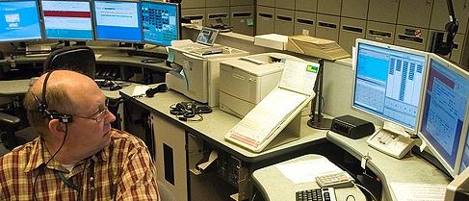

PALO ALTO POLICE DEPARTMENTS PSAP AND EOC
Serves City of Palo Alto & Stanford University
Radio Dispatch: PAPD, PAFD, Stanford DPS (Police), Public Works, Utilities, Animal Services & others
Daytime population is typically ~150,000, but can exceed 250,000 people (Stanford Football; holiday shopping at mall)
Average Daily 9-1-1 Calls: ~170 Police; ~20 Fire (almost all EMS medical) [does not include self-initiated officer activity or alarms; just calls from the public]
3rd Busiest Dispatch Center in Santa Clara County

Slide 35
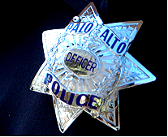
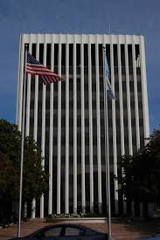
PALO ALTO PUBLIC SAFETY NUMBERS
Emergency: 9-1-1
Non-Emergency (24 Hours): 650-329-2413
Police Front Desk & General Information: 650-329-2406
Solicitor Permits, Block Parties:
650-329-2147
cityofpaloalto.org/publicsafety

Slide 36

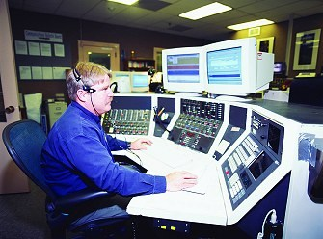
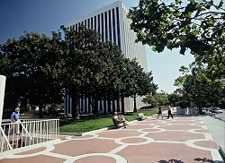
COMMUNICATIONS - 9-1-1
36
What happens when I call 9-1-1?
Location, Location, Location!
Nature of Emergency
Cell Phone =
May go to CHP

Slide 37
REPORT SUSPICIOUS ACTIVITY
You are the “Eyes and Ears” for the police. Get involved and help by reporting crime.
Be alert to unusual or suspicious behavior or activity.
Be a good witness.
Call 9-1-1, as soon as possible. Don’t hesitate by over-thinking it. We need the information as you see it.
We want to know about all suspicious activities in your neighborhood. You are the best person to know.
Never place your personal safety or the safety of those around you in jeopardy when attempting to get a better description of a subject. Make a mental picture of the suspect(s) and the environment

Slide 38
GOOD WITNESS CHECKLIST
Your Location
Give the dispatcher your exact location.
Allow the dispatcher to ask questions.
Do not hang up until directed by the dispatcher.
The Environment
What is the suspicious activity?
Where did it occur?
When did it occur?
View checklists & prevention tips on:
cityofpaloalto.org/StopCrime

Slide 39
GOOD WITNESS CHECKLIST cont.
Suspect
Gender
Approximate age
Race
Height and weight or build type
Skin tone
Clothing description (hat, coat, shirt, etc.)
Hair color and style (including facial hair)
Eye color and shape, glasses
Tattoos, scars, birthmarks
Weapons (gun, knife, stick, walking cane)
Direction suspect fled to and how?
Suspect’s identity (if you know)
Other distinguishing features
Vehicle
Remember the acronym
“CYMBALS”
C = Color of car
Y = Year
M = Make (Ford, BMW, Mini)
B = Body
A = Additional descriptive features
L = License plate number
S = State
How many occupants?
Last direction of travel?

Slide 40

Questions?
More Information:
cityofpaloalto.org/publicsafety

